Slide 1
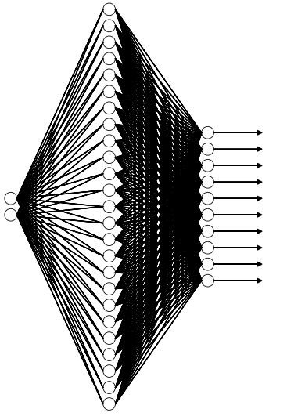
Benchmarking Neural Network Platforms
Base Network Architecture:
Loss Function = Cross Entropy
Optimizer = Gradient Descent
Learning Rate = 0.01
Hidden: 25, Relu Activation
Platforms Tested:
TensorFlow
PyTorch
CNTK
Training Dataset:
Subset of MNIST handwriting recognition dataset.
5000 handwritten numbers 0 to 9.
20x20 Images (400 Flattened Pixels)
Out: 10, Relu Activation
Input:
400 Pixel Values
Softmax

Slide 2
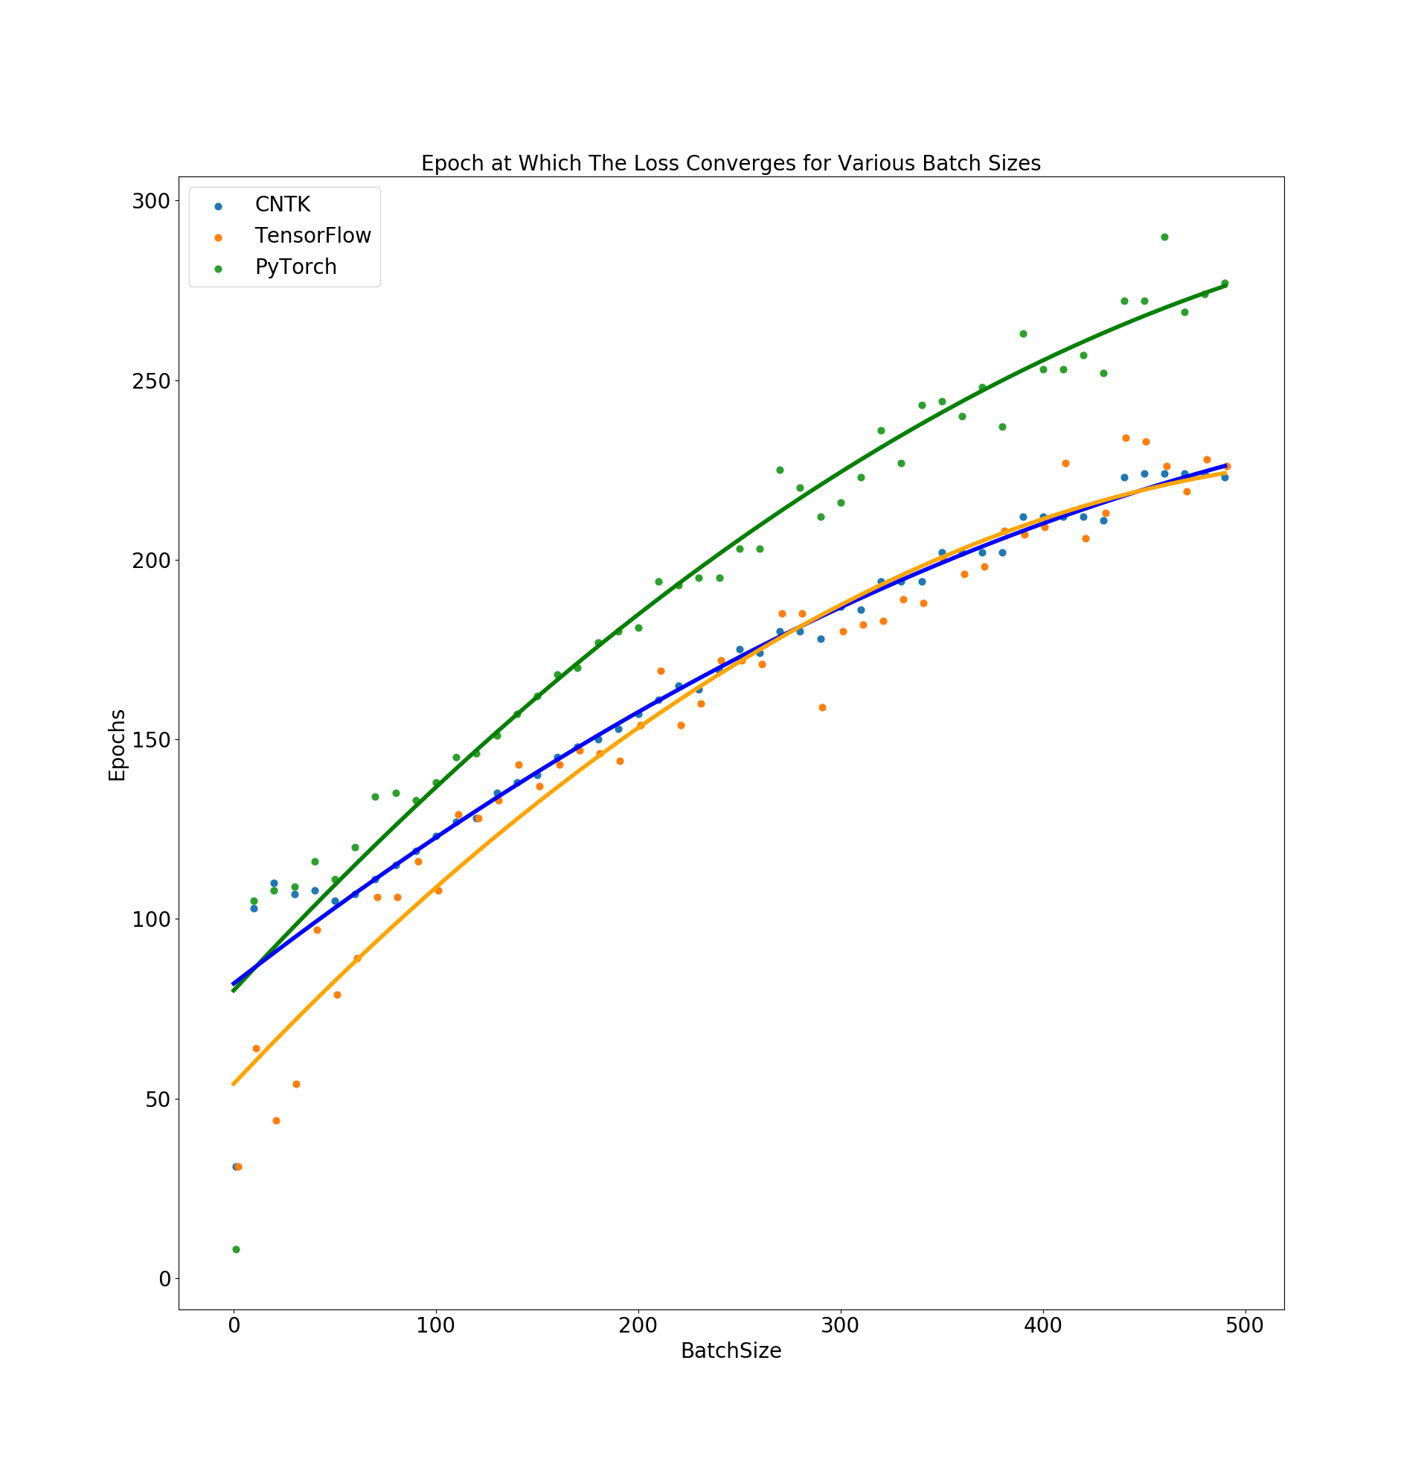
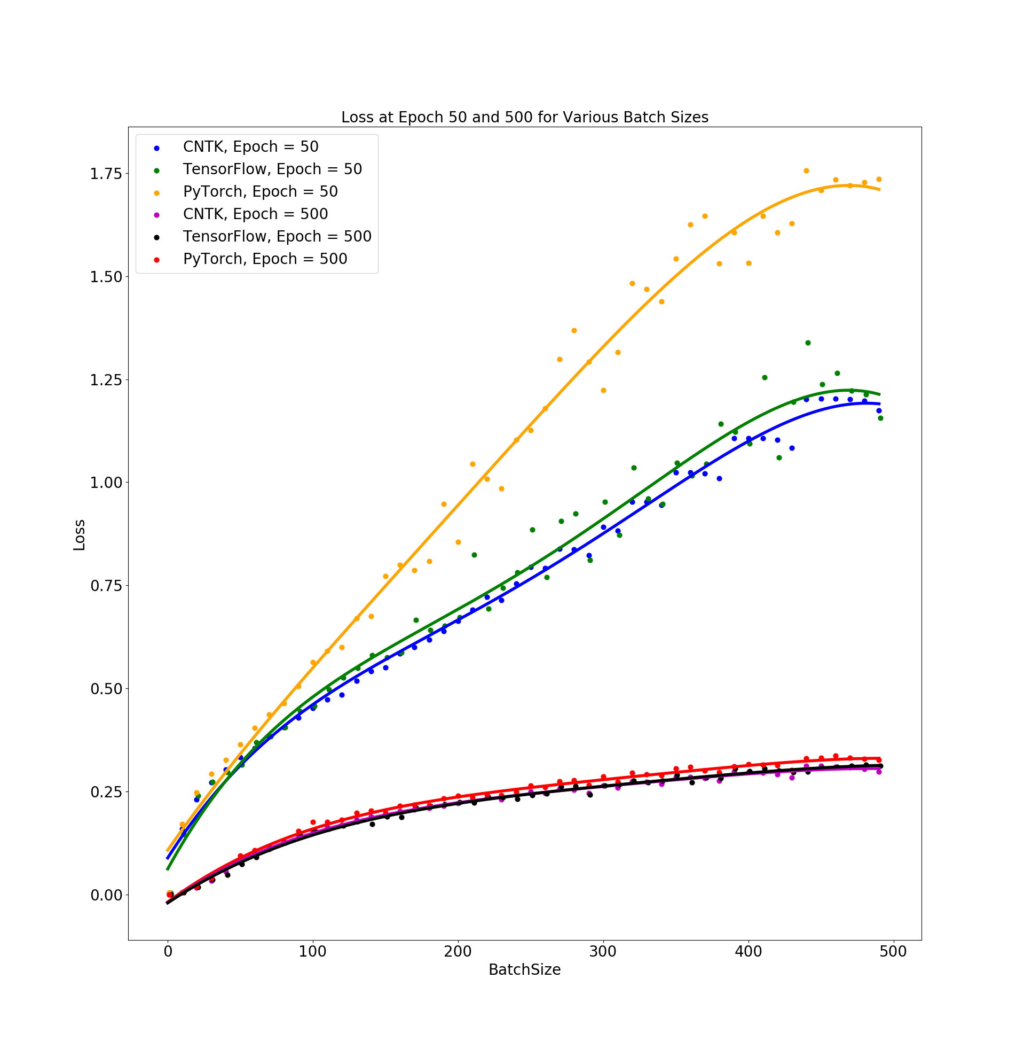
Variable Batch Size

Slide 3
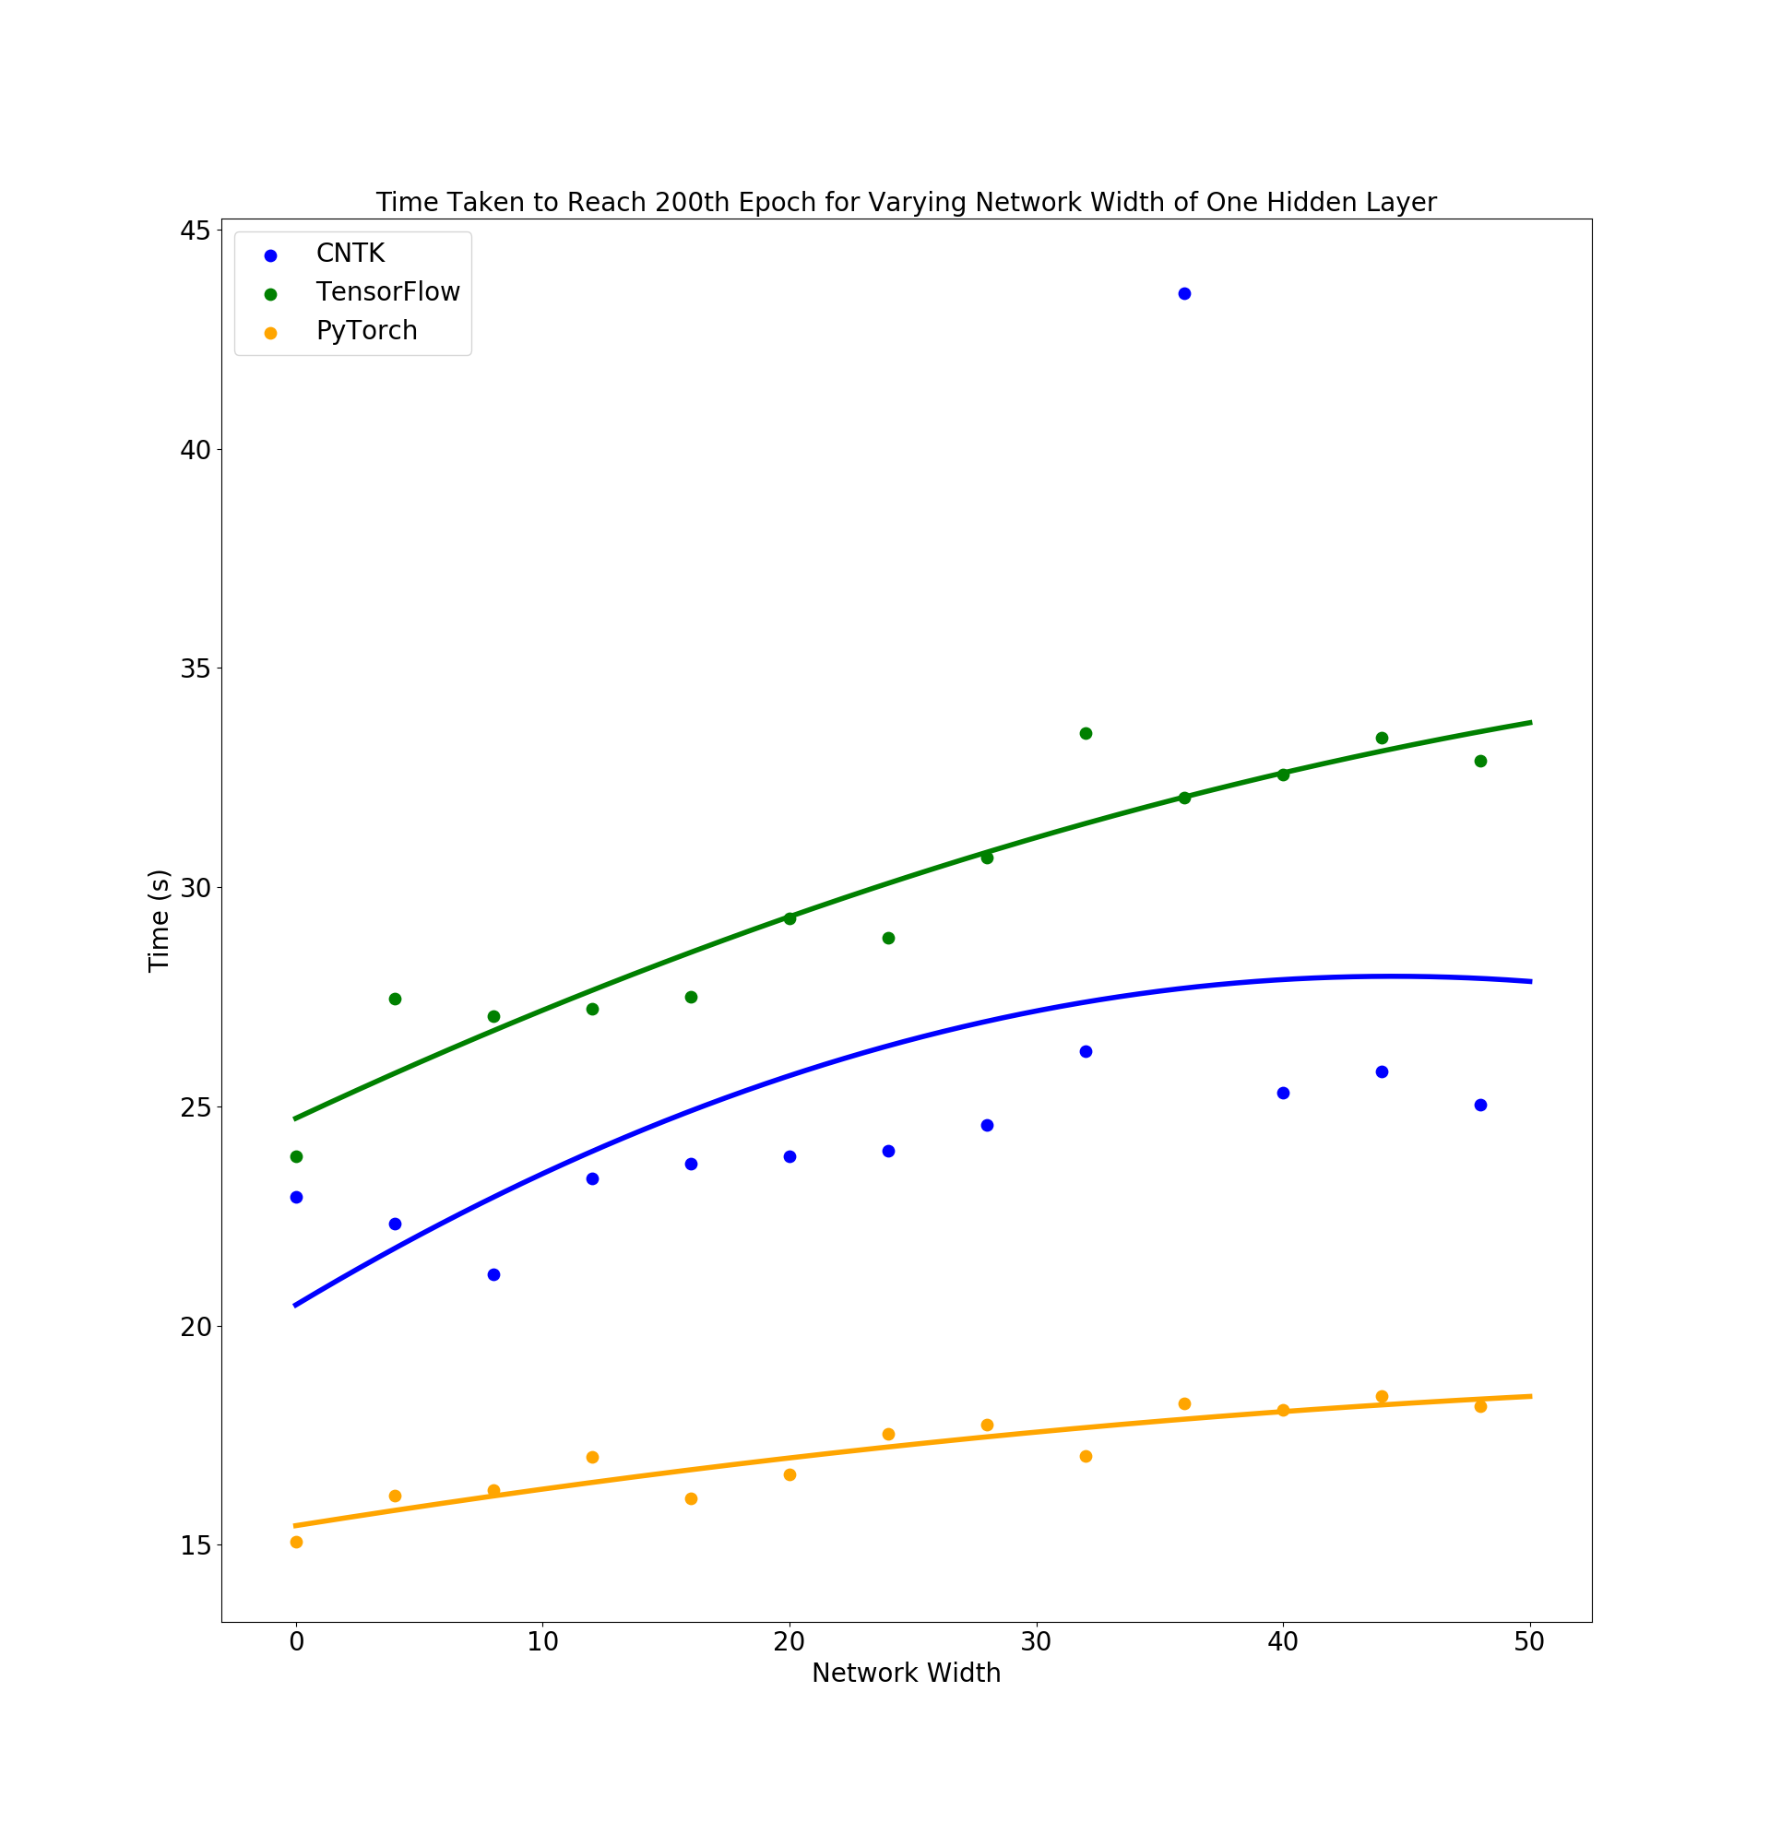
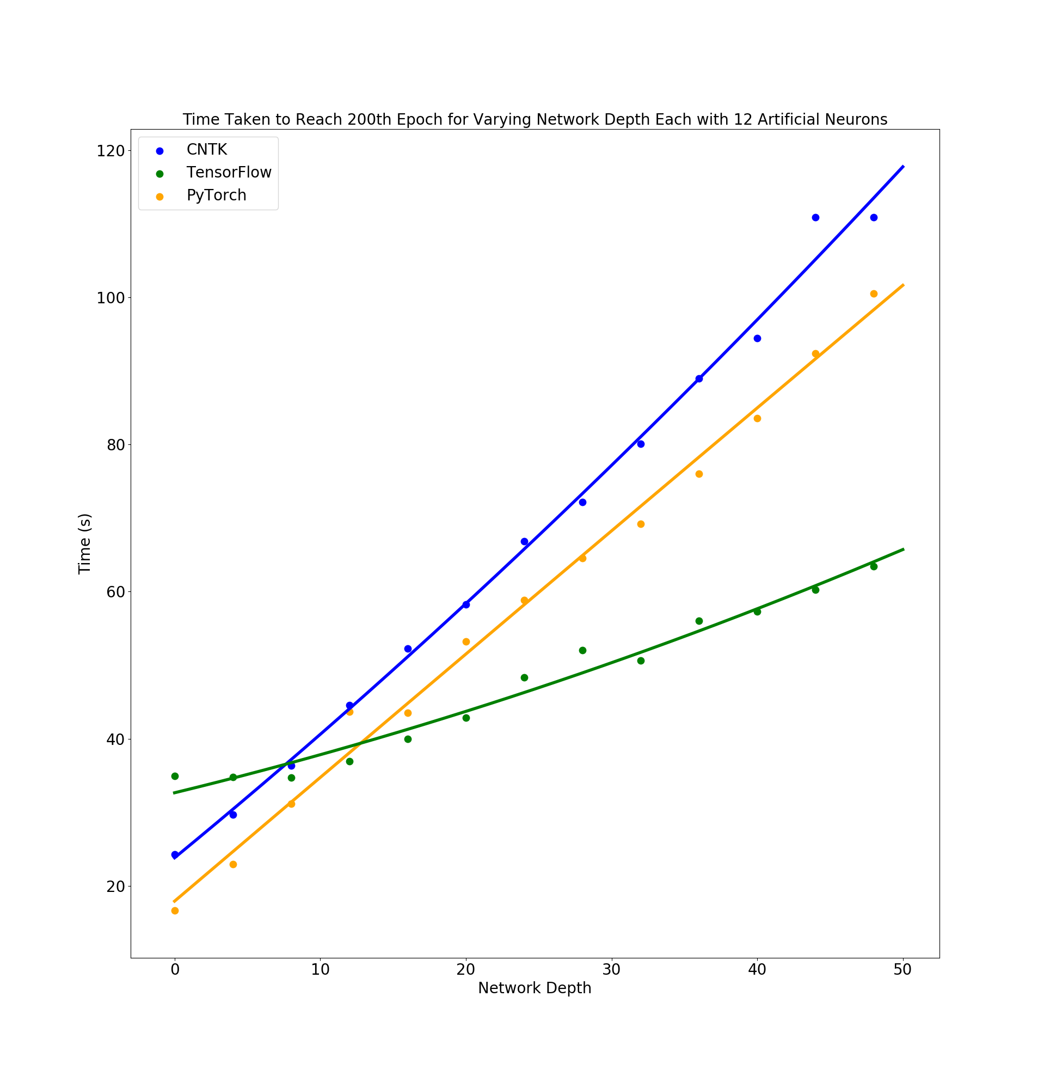
Variable Network Width/Depth Vs Time

Slide 4
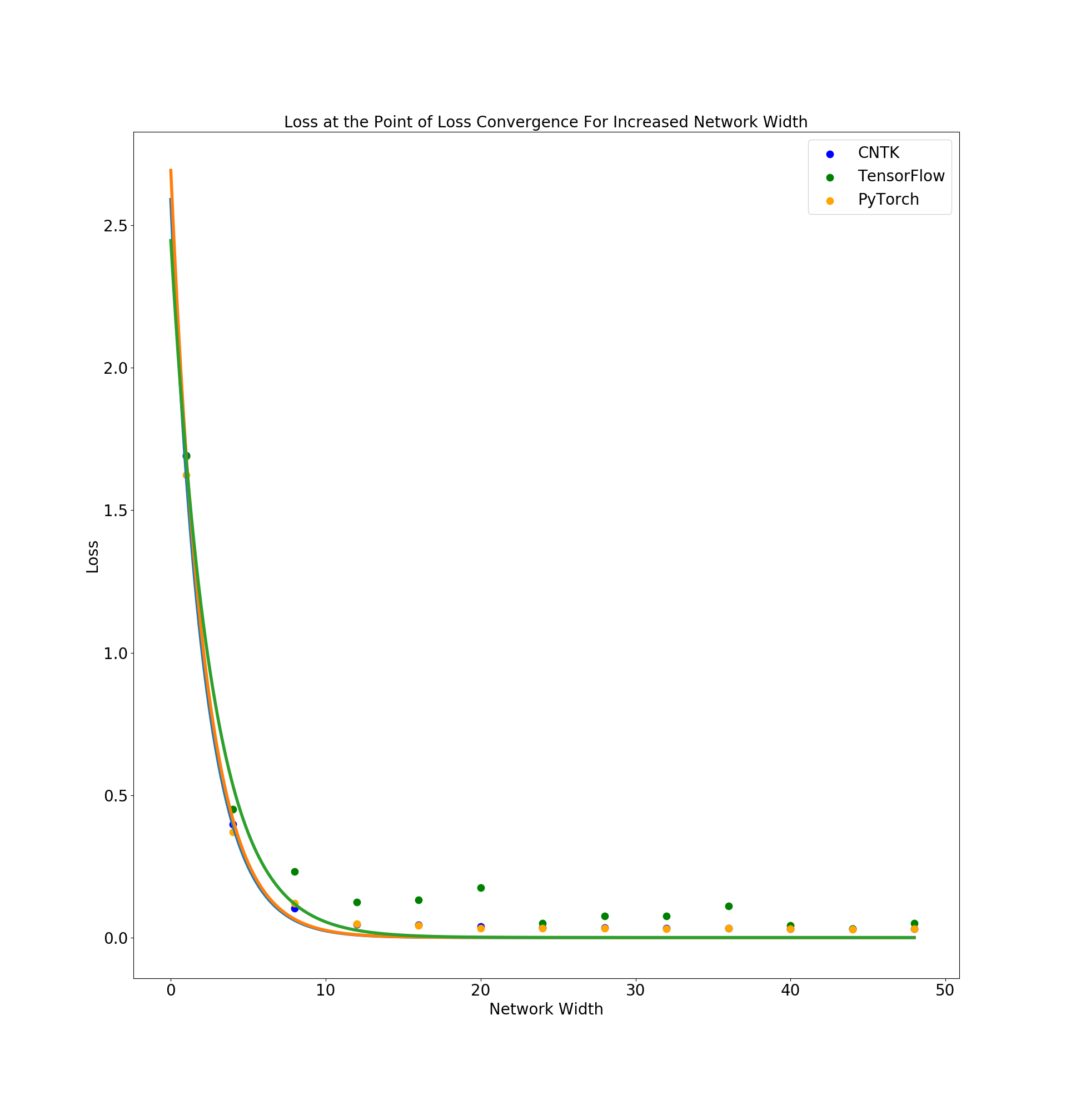
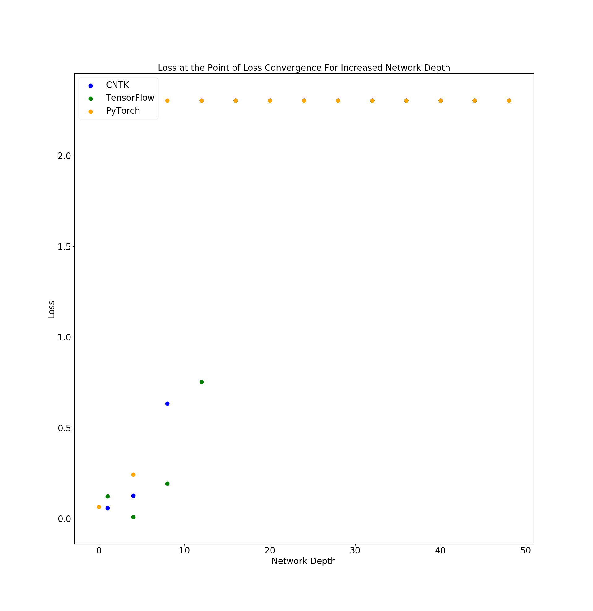
Variable Network Width/Depth Vs Convergence Loss

Slide 5
Classification of RR Lyrae Stars
Aim: Compare Traditional Machine Learning To Neural Networks
Classifying between non variable and variable main sequence stars.
Each data point consists of 4 color values in different regions of the light spectrum [ u-g , g-r , r-i , i-z ].
Traditional Method:
Gaussian Naive Bayes Classification
Network Details:
Using Keras with TensorFlow backend.
Network Input: 2-4 color values for each star.
Network Output: Classification between 1 (Variable Star) and 0 (Non Variable).

Slide 6
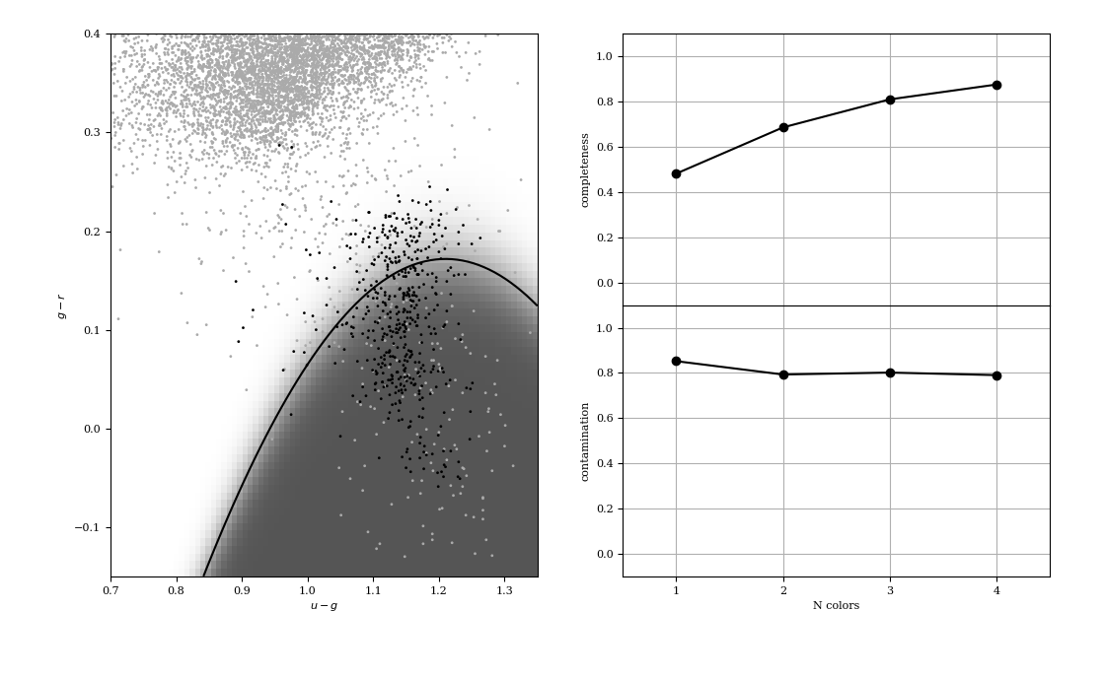
Gaussian Naive Bayes Classification of RR Layrae Stars
of RR Layrae Stars
Data Imbalance: 1:225 ratio of Class 1 (Black, Variable Stars) to Class 0 (Grey, Non-Variable Stars)
[ u-g , g-r , r-i , i-z ]

Slide 7
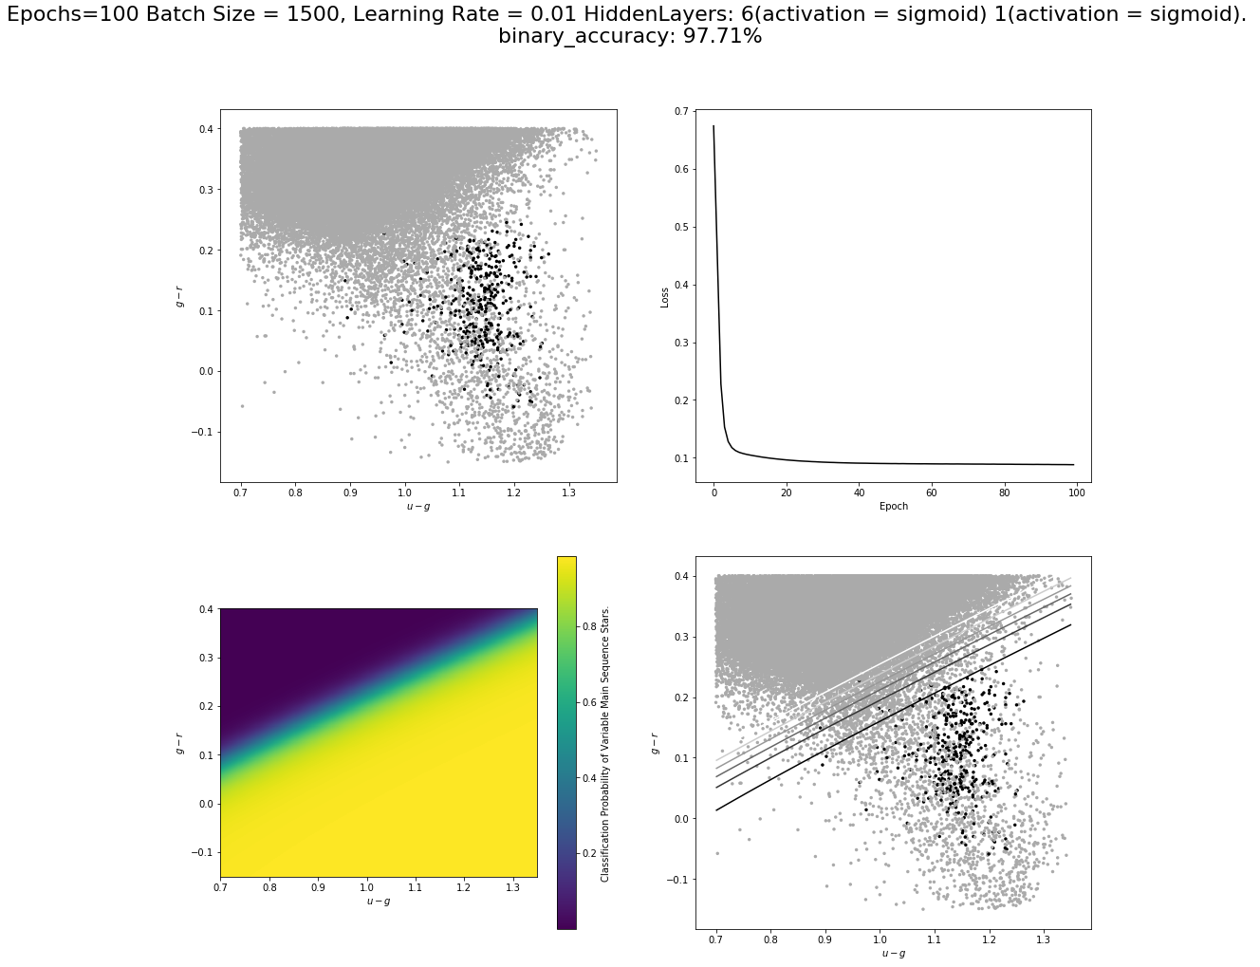
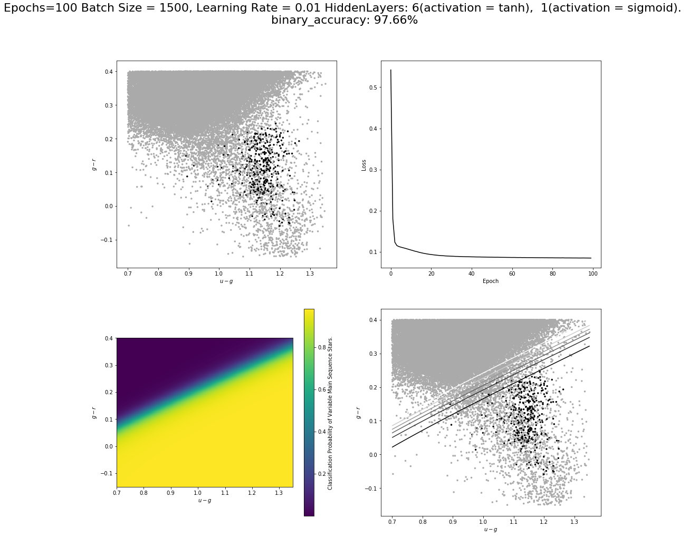
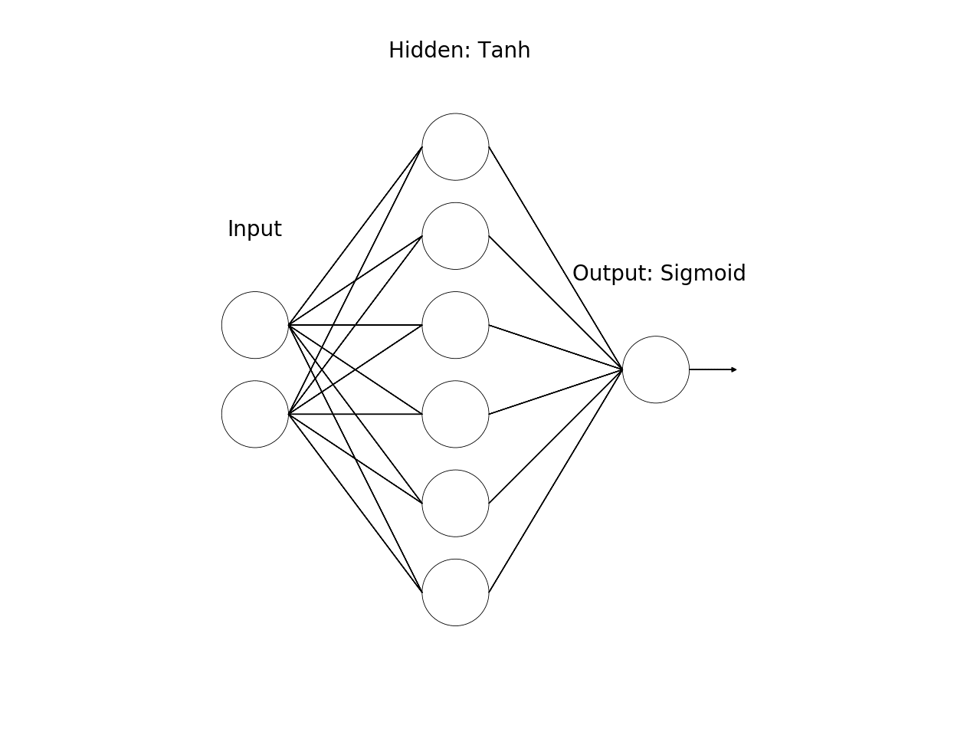
Data Imbalance: 1:225 ratio of Class 1 (Black) to Class 0 (Grey)

Slide 8
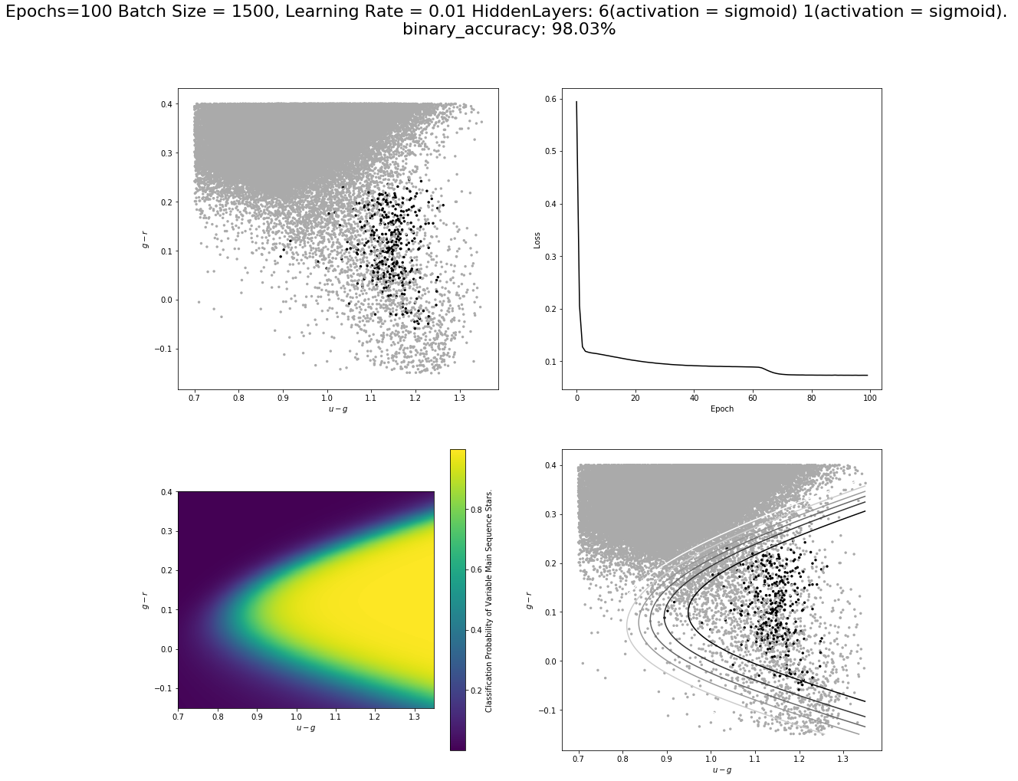
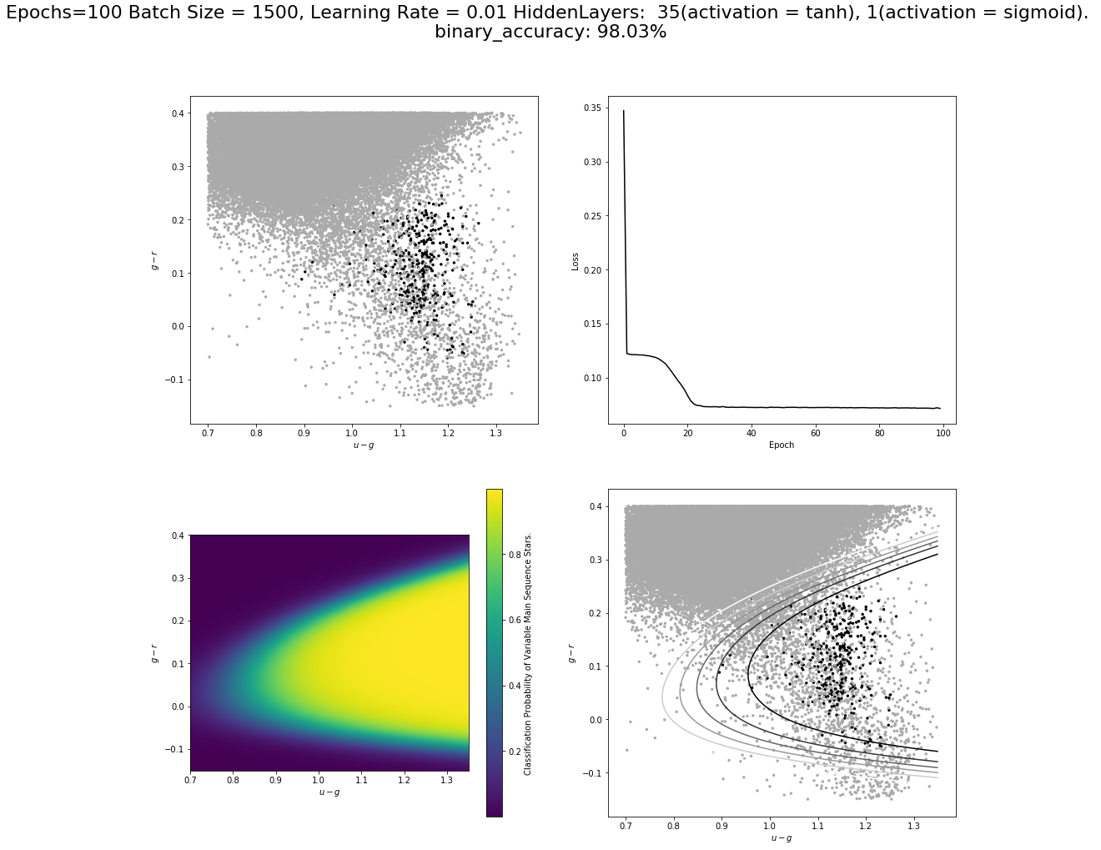
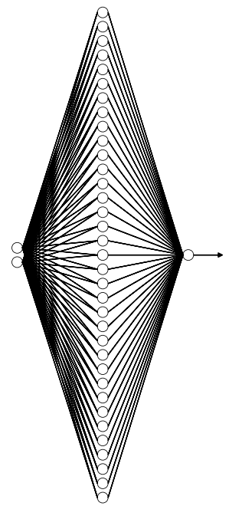
Hidden: 35, tanh
Input: 2,3,4
Out: 1, Sigmoid

Slide 9
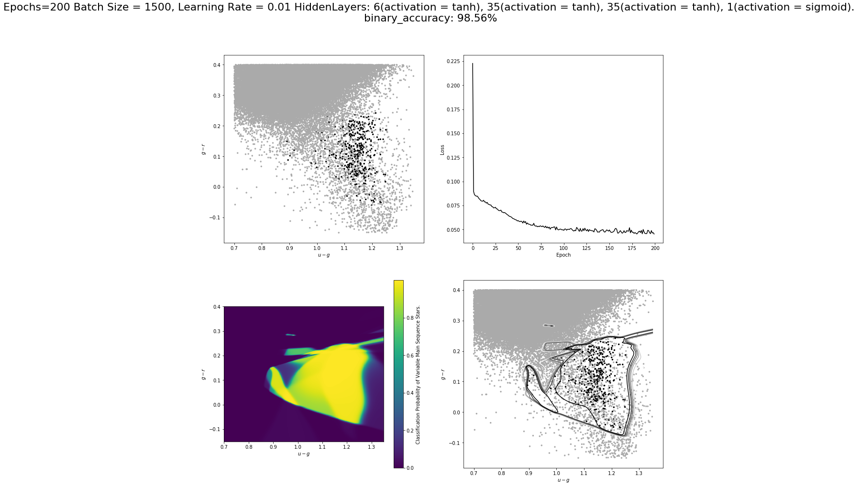
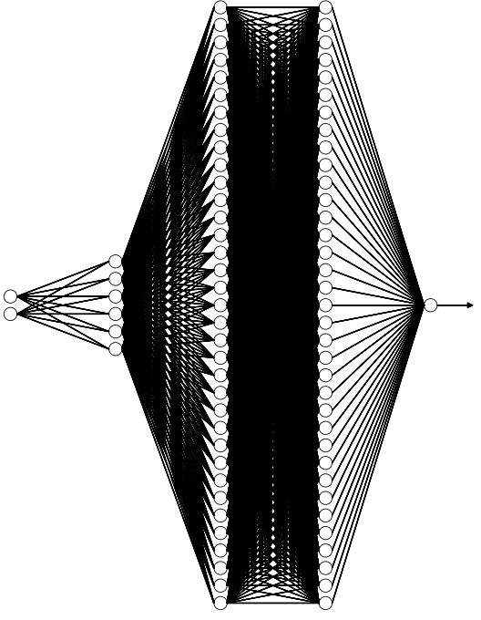
Hidden: 35 x 2, tanh
Hidden: 6, tanh
Out:
1, Sigmoid
Input: 2,3,4

Slide 10
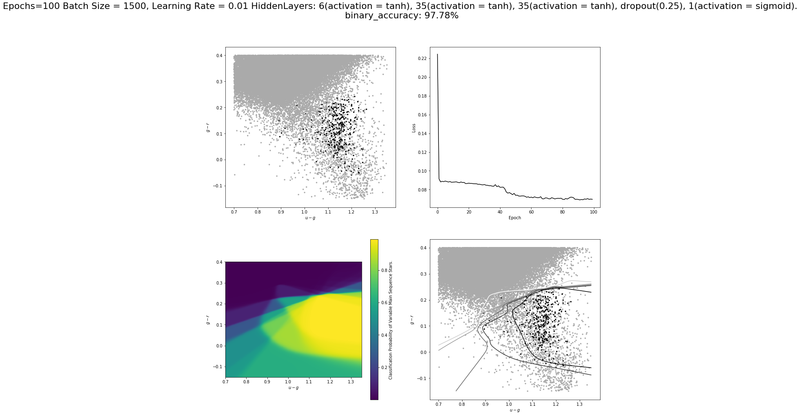
Hidden: 35 x 2, tanh
Hidden: 6, tanh
Out:
1, Sigmoid
Input: 2,3,4
Dropout(0.25)

Slide 11
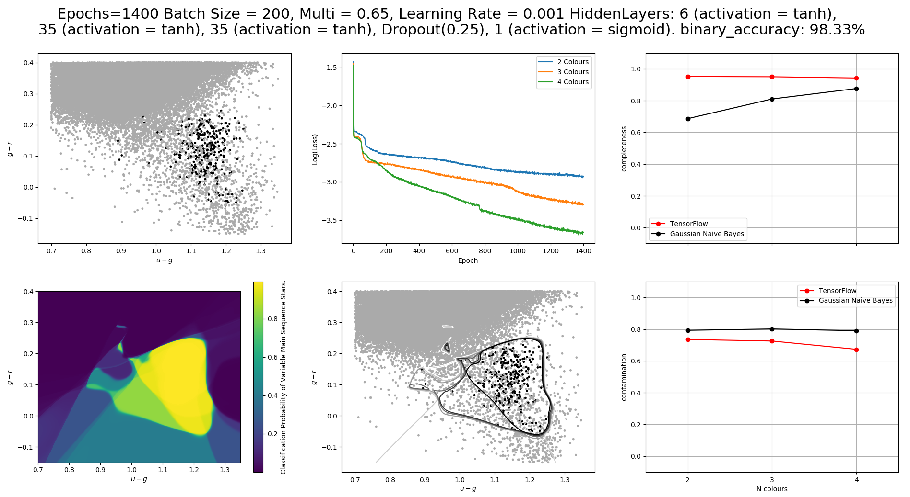

Slide 12
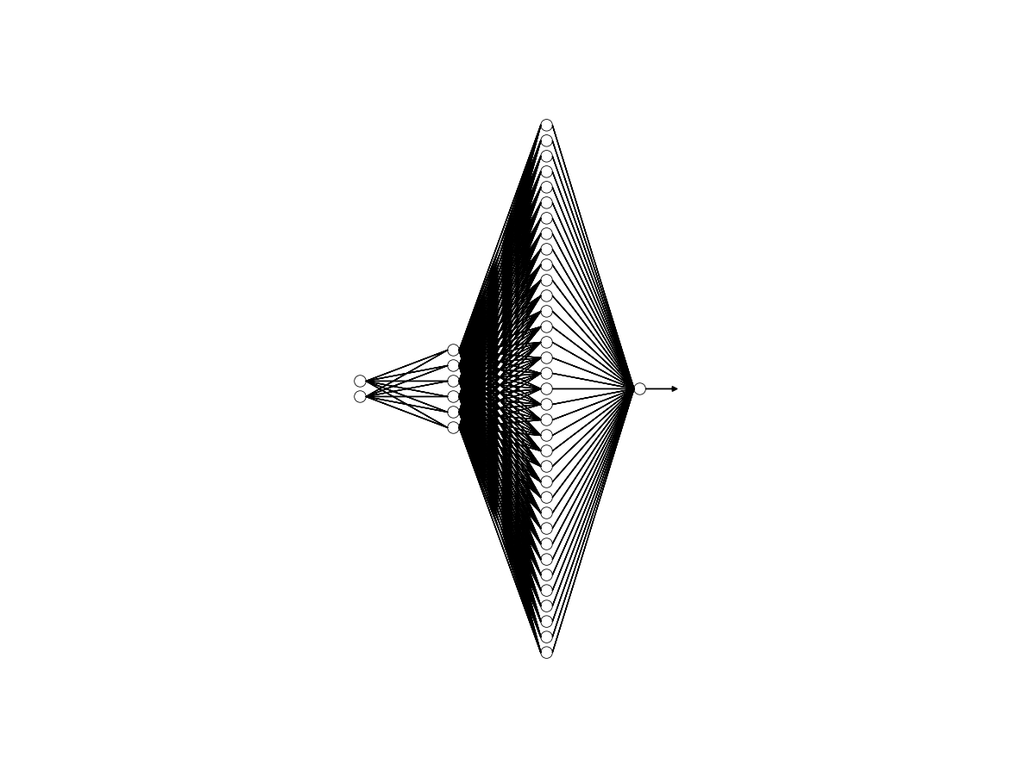
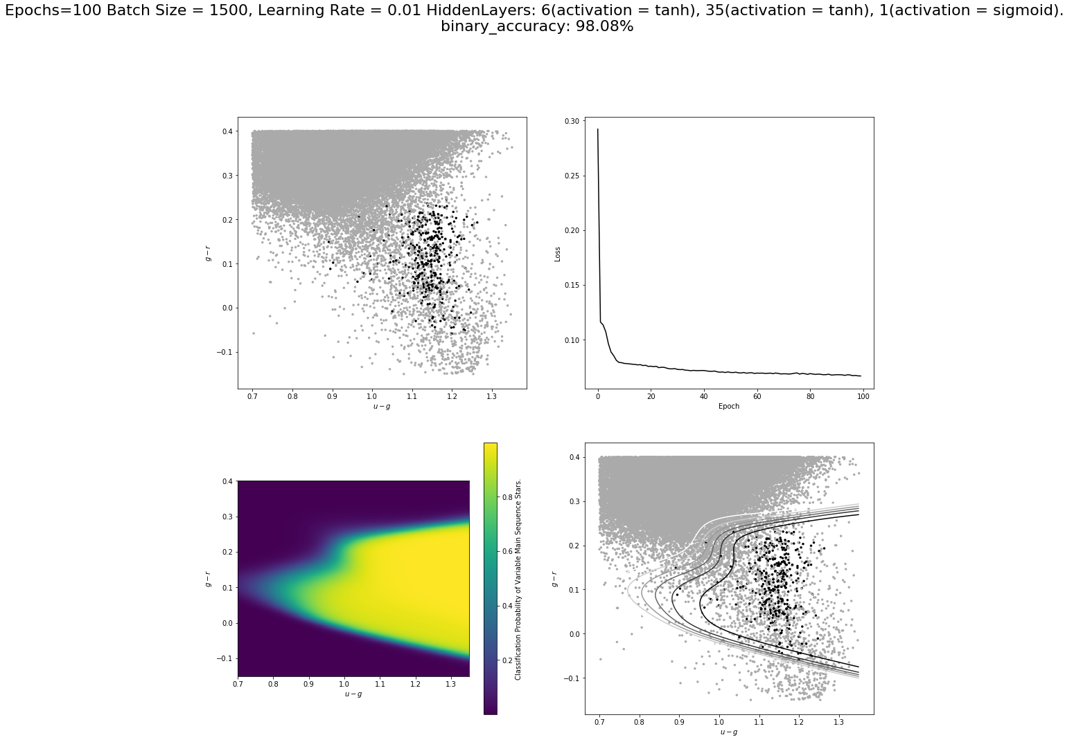
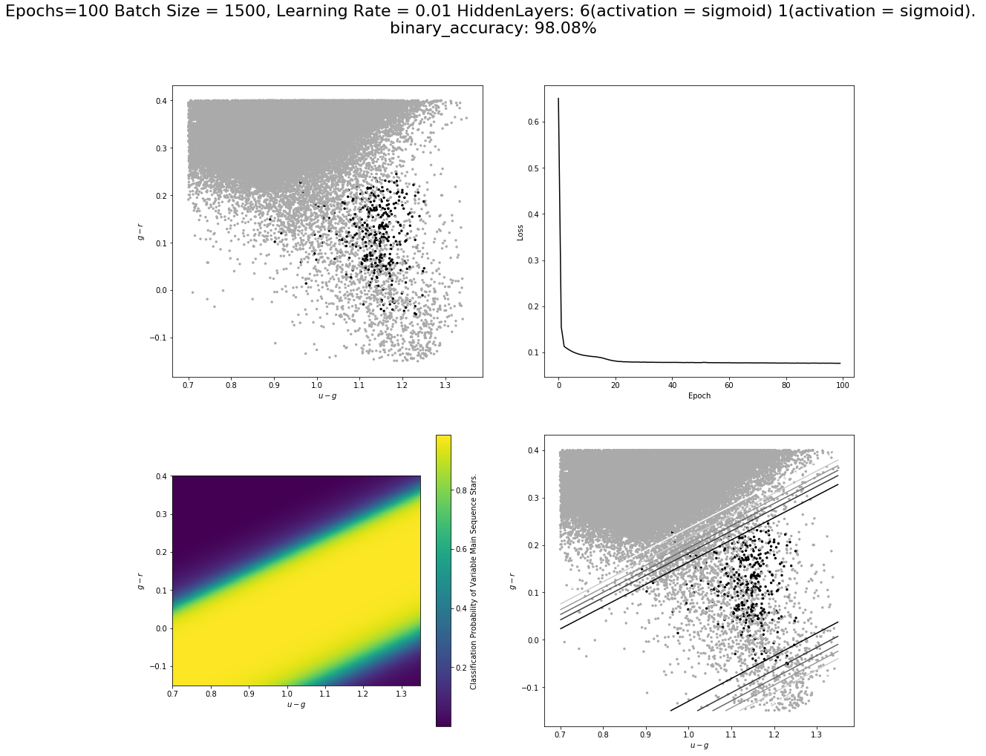
Hidden: 35, tanh
Hidden: 6, tanh
Out: 1, Sigmoid
Input: 2,3,4

Slide 13
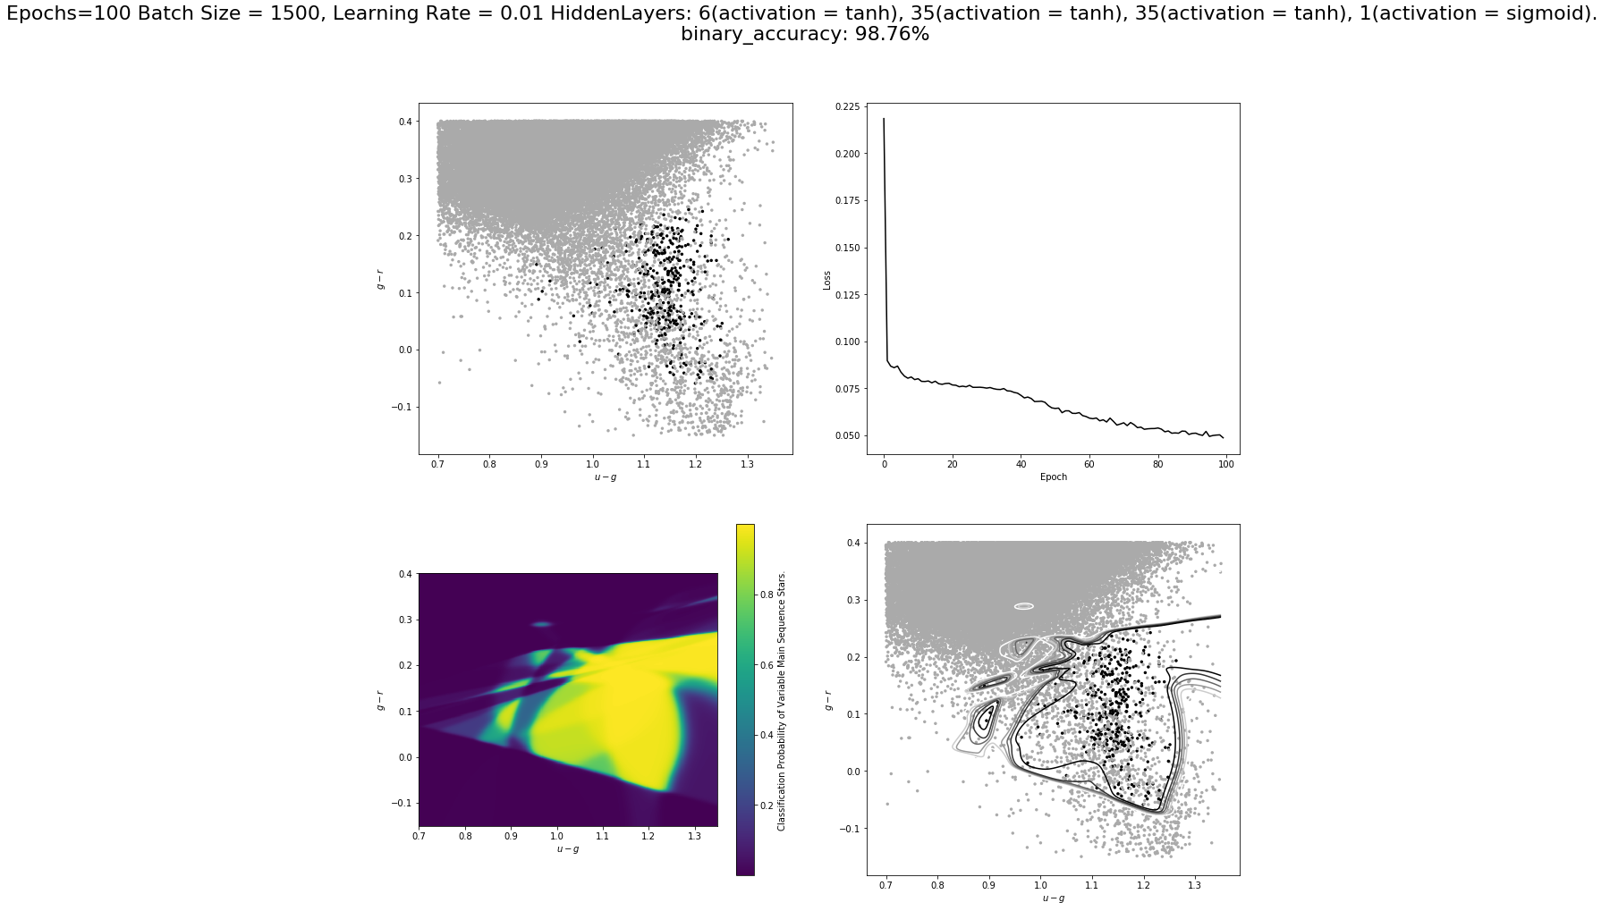

Slide 14
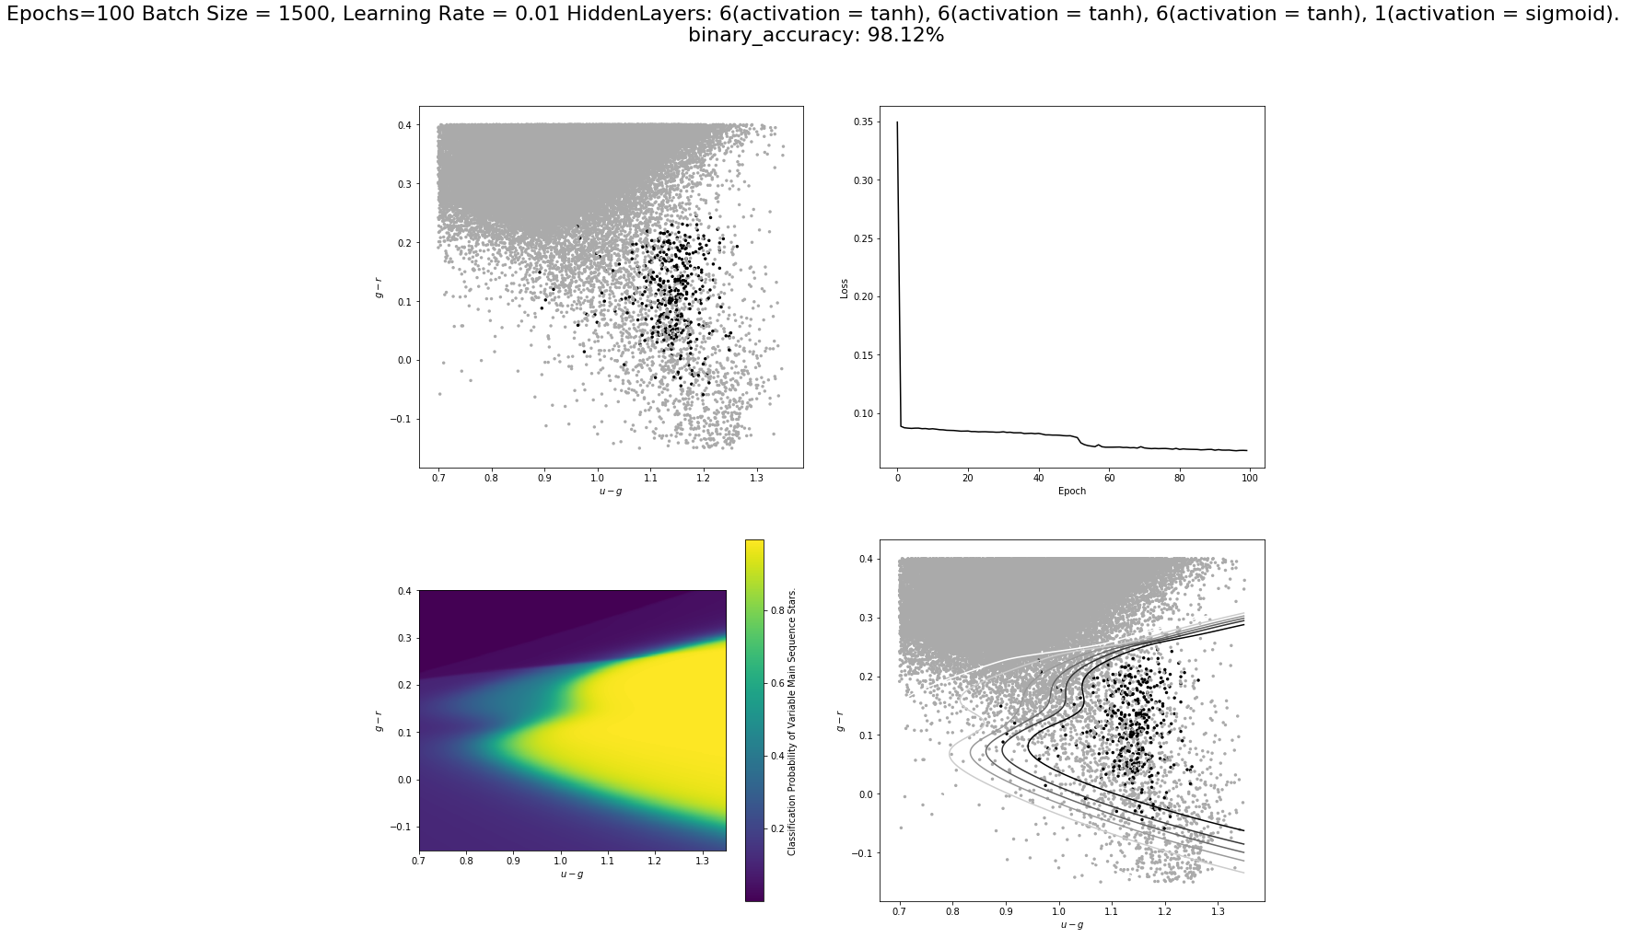

Slide 15
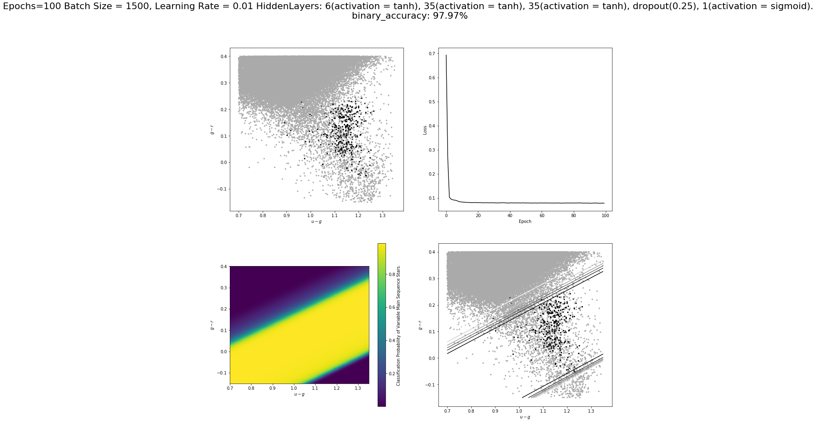
All sigmoid

